Slide 1

Restaurant Management System
CSAI 202 - Database Systems | Fall 2025
Team 1
Ahmed Ezzat Allam - 202402481
Ahmed Qwisy - 202402475
Abdelrahman Harby - 202401982
Mohamed Elbadawy - 202401083

Slide 2
Project Objectives
Digitize Operations
User Experience
Transform traditional restaurant ordering into a web-based system.
Facilitate browsing menus, adding items to the cart, and placing orders online.
Admin Control
Data Integrity
Provide a dashboard for managing menu items (CRUD) and tracking customer orders.
Ensure secure storage for user data and order details using a relational database.

Slide 3
System Actors
1. Customer:
2. Administrator:
Register & Login.
Manage Menu Items (Add, Edit, Delete).
Browse Menu & Search by Category.
View Order History.
Manage Shopping Cart.
Manage System Users.
Place Orders.

Slide 4
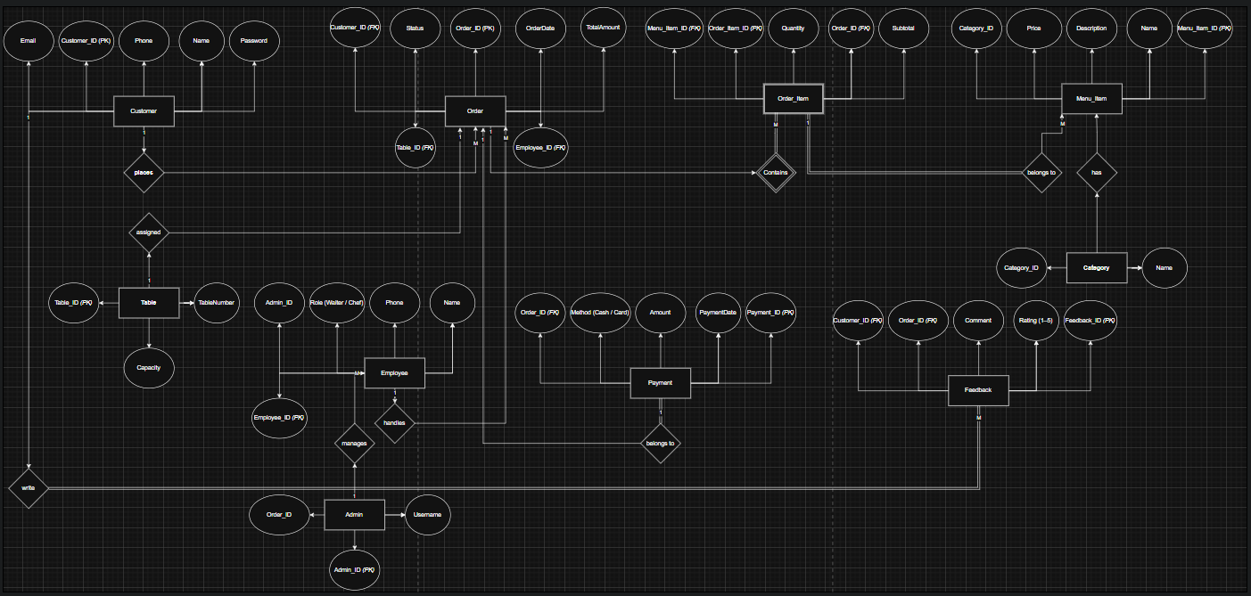
Database Design (ER Diagram)
Key Relationships:
One-to-Many: Customer places many Orders.
Many-to-Many: An Order contains many Items, and an Item appears in many Orders.
Solution: Resolved using OrderDetail junction table to store Quantity.

Slide 5
Technologies & Tools
Backend
Database
ORM
ASP.NET Core MVC (.NET 8).
Microsoft SQL Server (SSMS).
Entity Framework Core (Code-First Approach).
Frontend
Version Control
HTML5, CSS3, Bootstrap.
Git & GitHub.

Slide 6
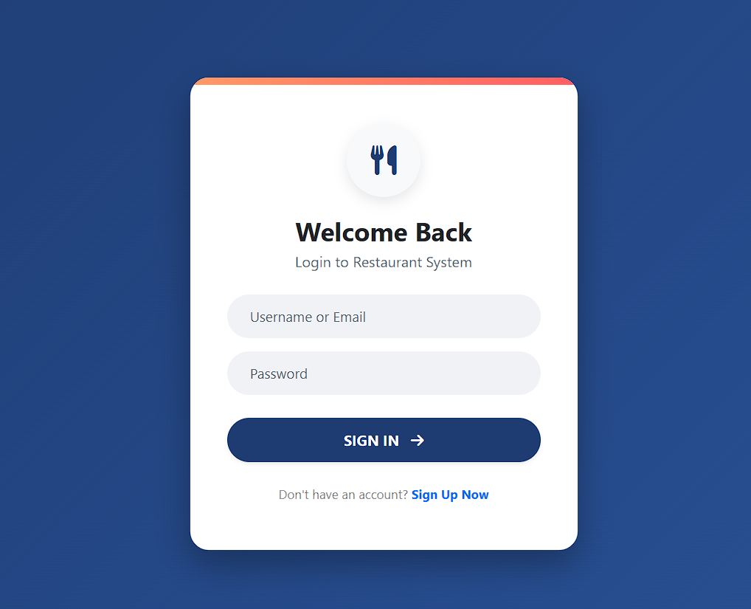
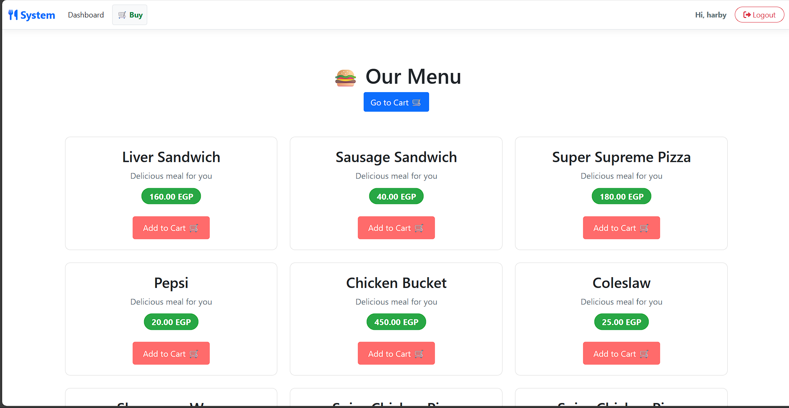
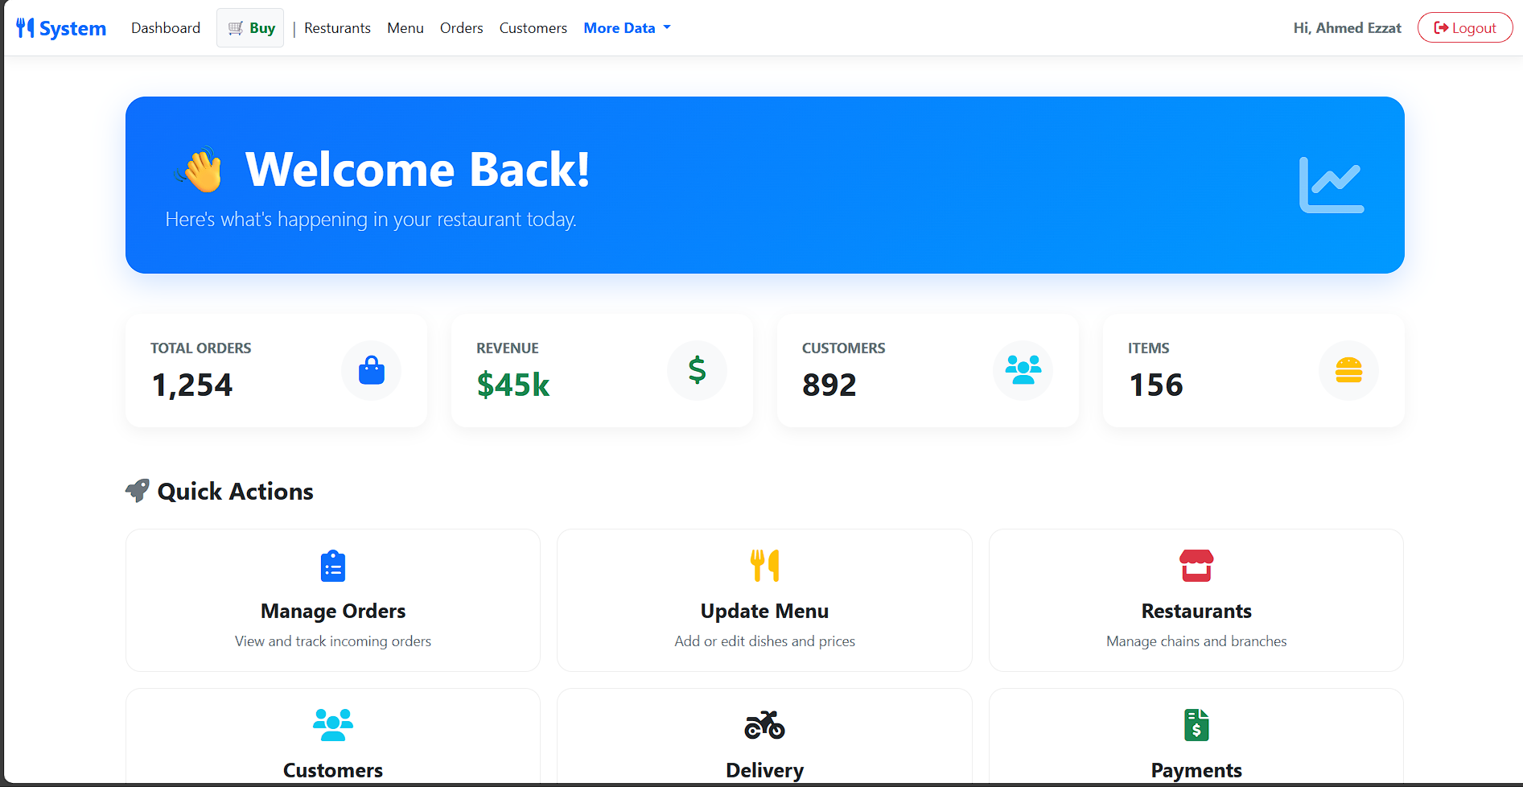
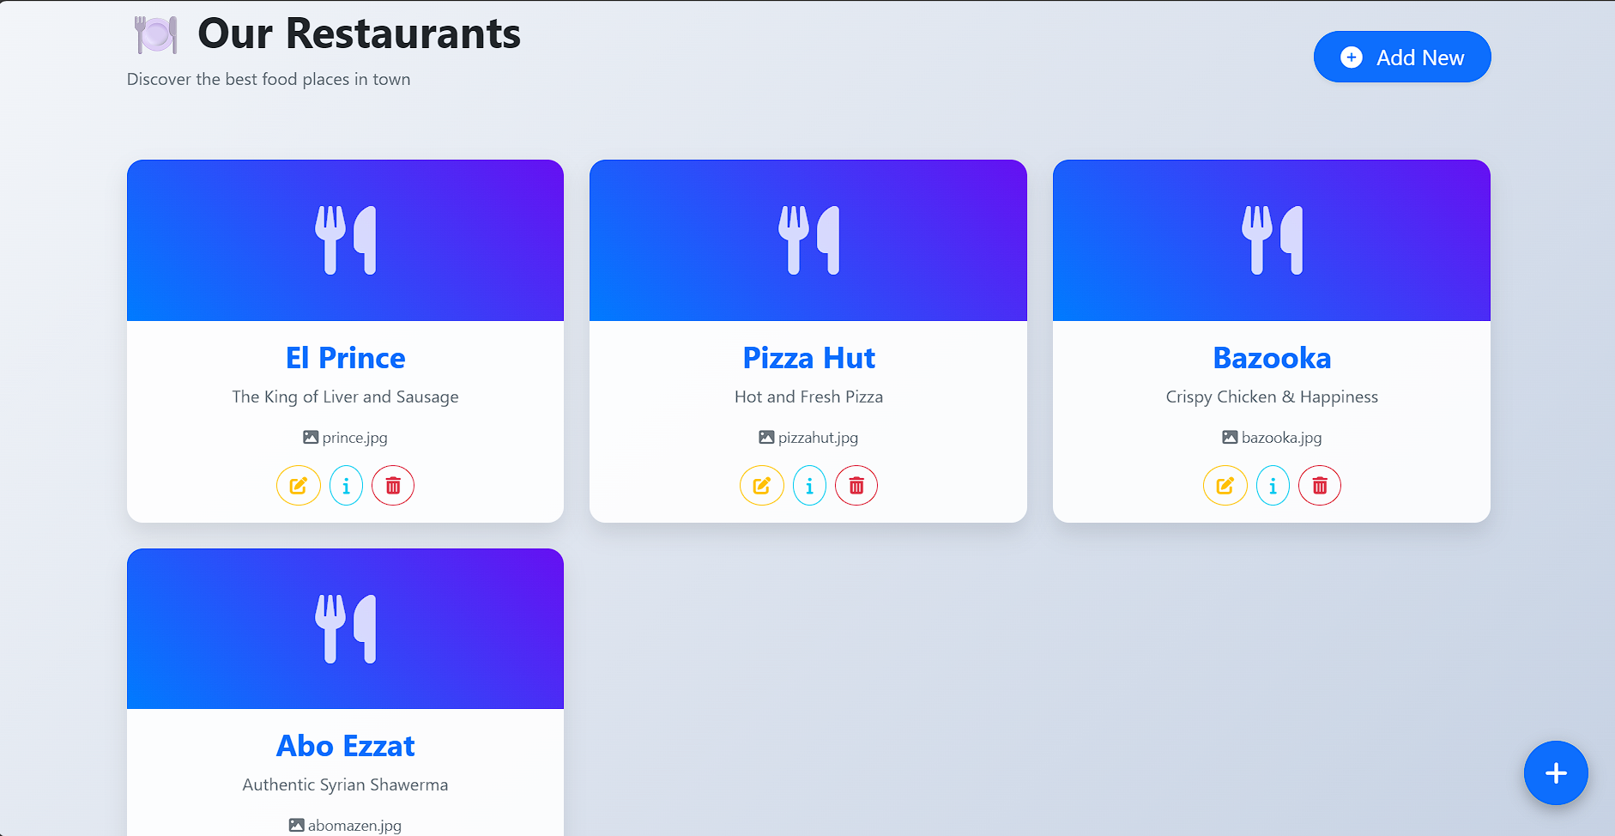
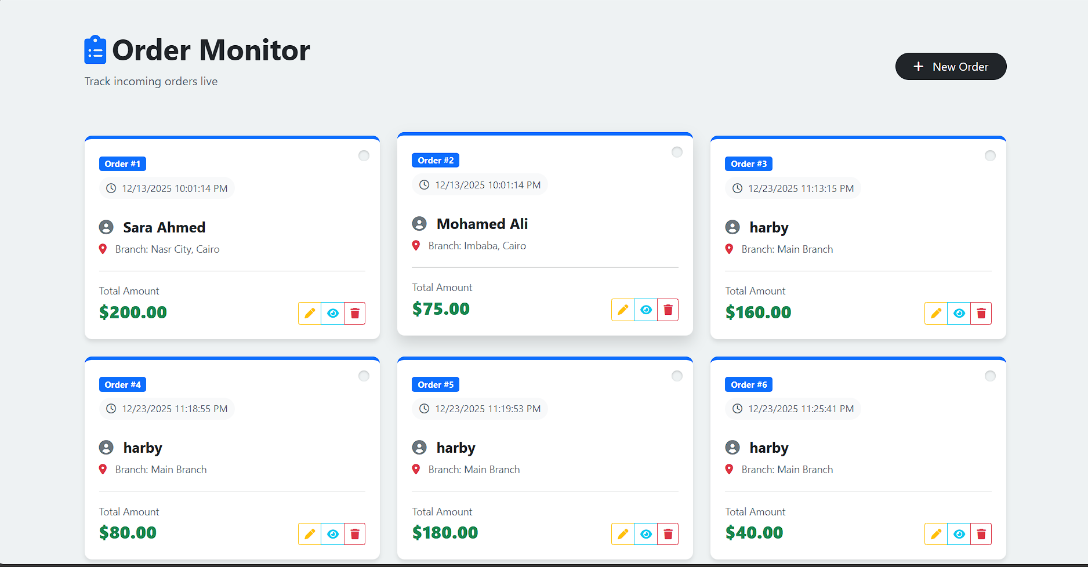
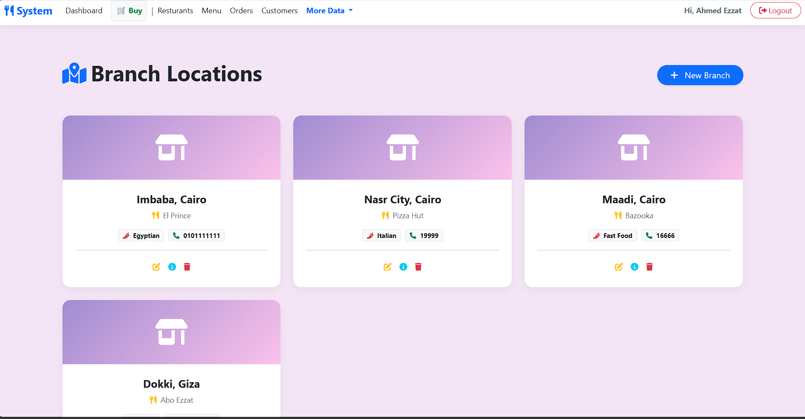
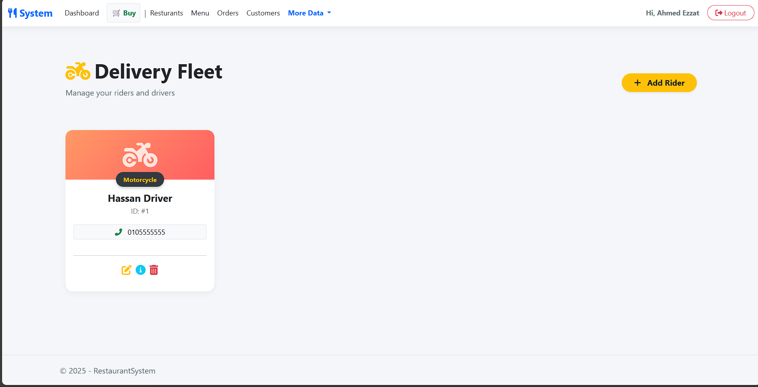
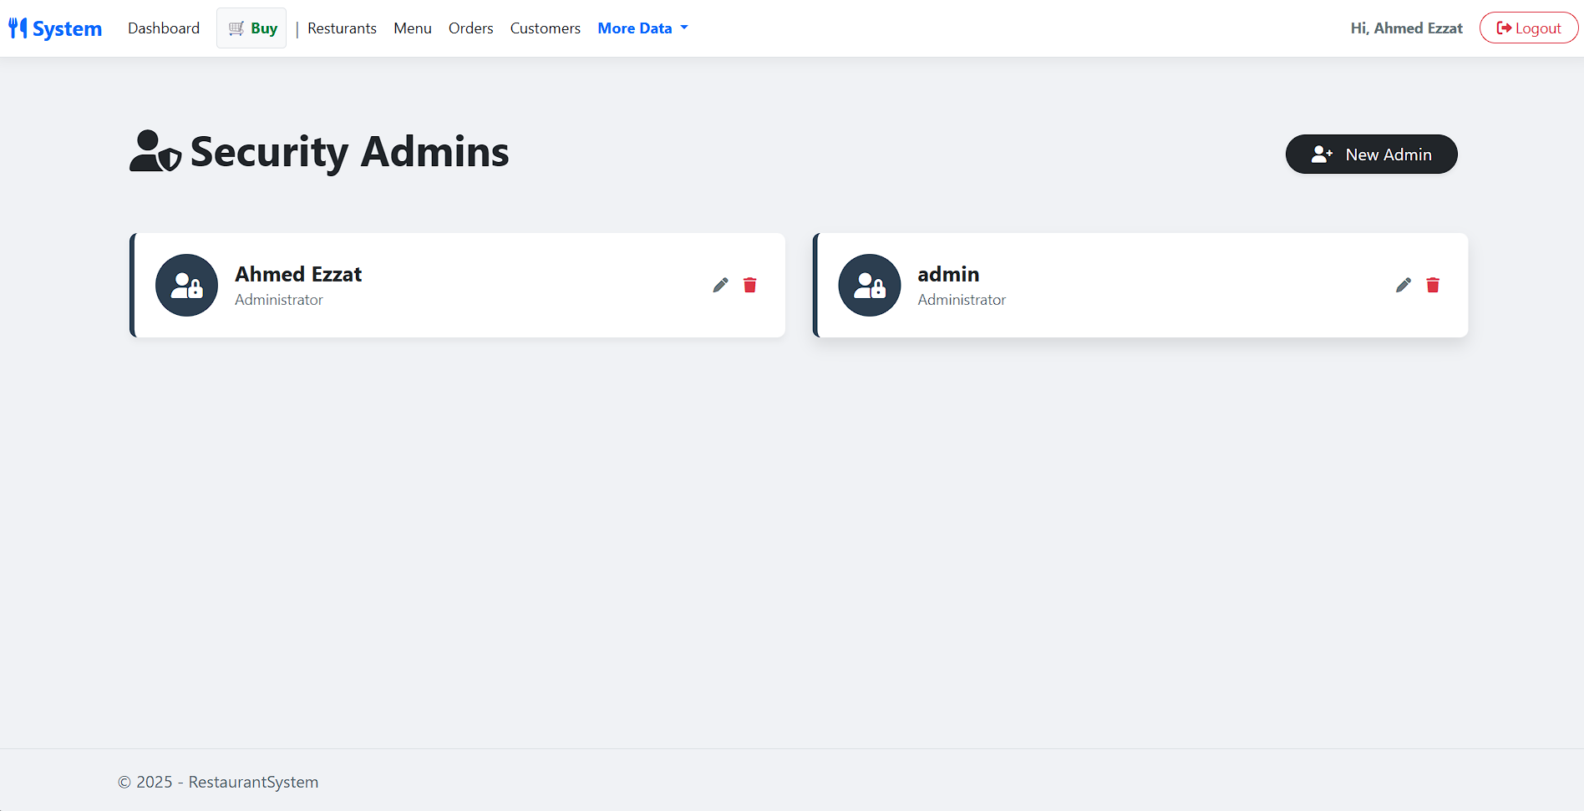
System Implementation

Slide 7
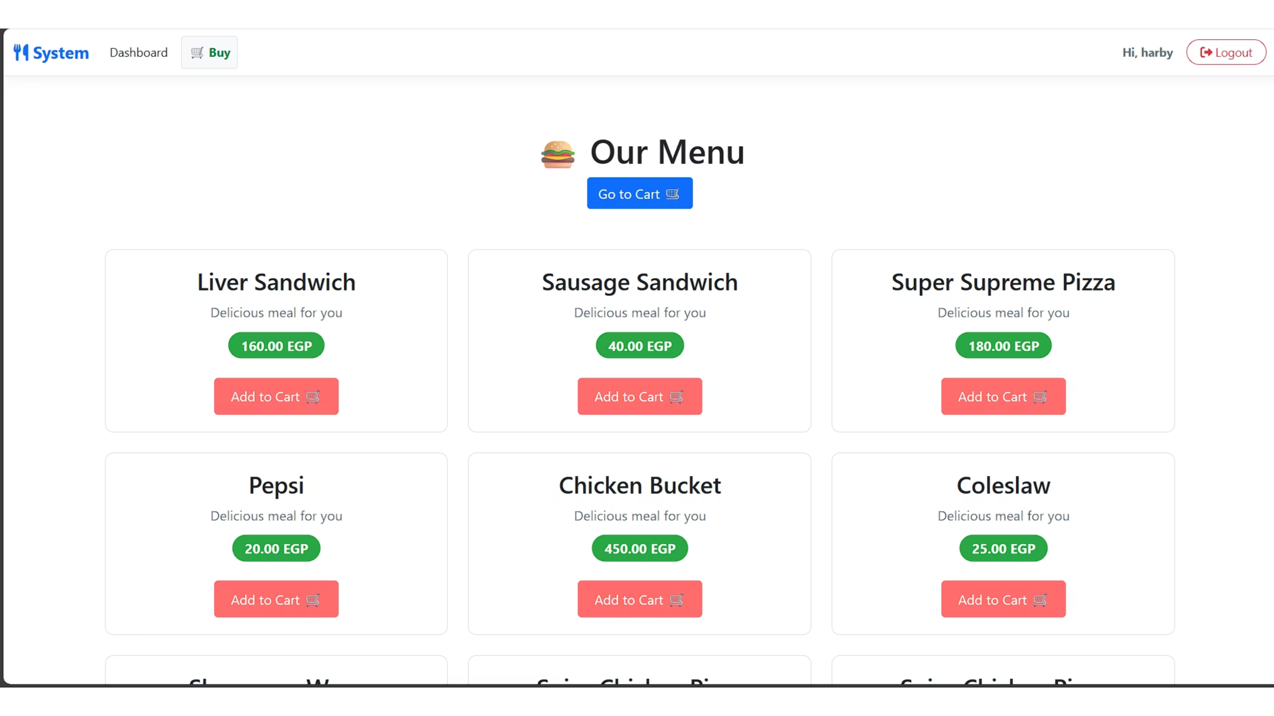

Slide 8
Conclusion & Future Work
Achievements:
Future Enhancements:
Successfully built a full-stack MVC application with a structured database.
Payment Gateway Integration.
Order Tracking Status (Preparing, Delivered).
Workload:
Review & Rating System.
Tasks were distributed among team members (Backend, Frontend, Database, Documentation).
Thank You!
Any Questions?

